Slide 1

American Express Makeathon 2023
ML-based fraud detection
BY: Akriti gupta

Slide 2
Introduction
In today's digital age, where financial transactions occur at an unprecedented scale, the need for robust fraud detection mechanisms is paramount. Fraudulent activities can be detrimental to any organization, causing significant financial losses and damage to reputation. The traditional rule-based fraud detection systems are often inadequate to keep up with the ever-evolving techniques used by fraudsters. With the exponential growth of electronic transactions, detecting fraudulent activities has become more challenging. The trend of online shopping is growing day by day. Credit cards are used for purchasing goods and services with the help of virtual card and physical card for offline transaction. In online payment mode, attackers need only little information for doing fraudulent transaction.
In response, machine learning models can be used to automatically analyze large amounts of data and identify fraudulent patterns with high accuracy. The system leverages the power of machine learning algorithms to analyze vast amounts of data and identify patterns indicative of fraudulent activities. By combining cutting-edge techniques with real-time monitoring, the model provide a comprehensive solution that protects businesses and individuals from financial losses, safeguards sensitive information, and preserves trust in online transactions.

Slide 3
Problem statement
Develop and maintain ML-based fraud detection models that are effective at identifying evolving fraud patterns even in the presence of imbalanced data.
The goal of ML-based fraud detection is to develop models that can detect fraud patterns in real-time, while minimizing false positives and false negatives. By addressing the challenges outlined in the problem statement, businesses and individuals can better protect themselves from the financial and reputational damage caused by fraud.

Slide 4
Technologies used
Machine Learning
Machine learning is a branch of artificial intelligence(AI) and computer science which focuses on the use of data and algorithms to imitate the way that humans learn, gradually improving its accuracy. Machine learning is an important component of the growing field of data science. Through the use of statistical methods, algorithms are trained to make classifications or predictions. Machine learning algorithms build a model based on sample data, known as training data, in order to make predictions or decisions without being explicitly programmed to do so. Machine learning algorithms are used in a wide variety of applications, such as in medicine, fraudulent detection , email filtering, speech recognition, agriculture, and computer vision, where it is difficult or unfeasible to develop conventional algorithms to perform the needed tasks.

Slide 5
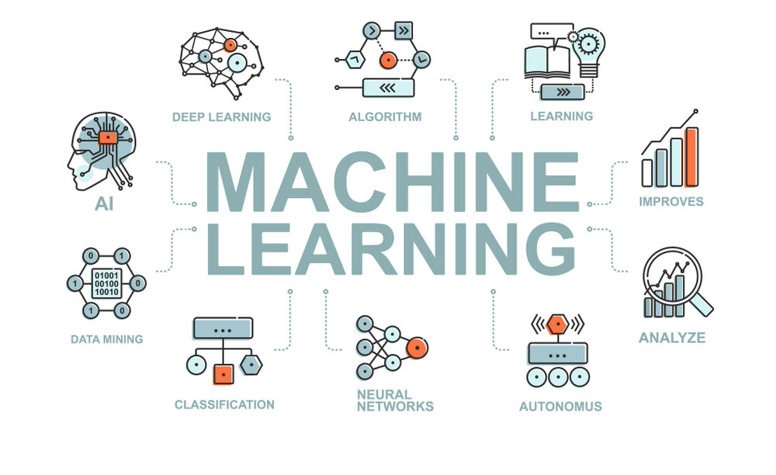

Slide 6
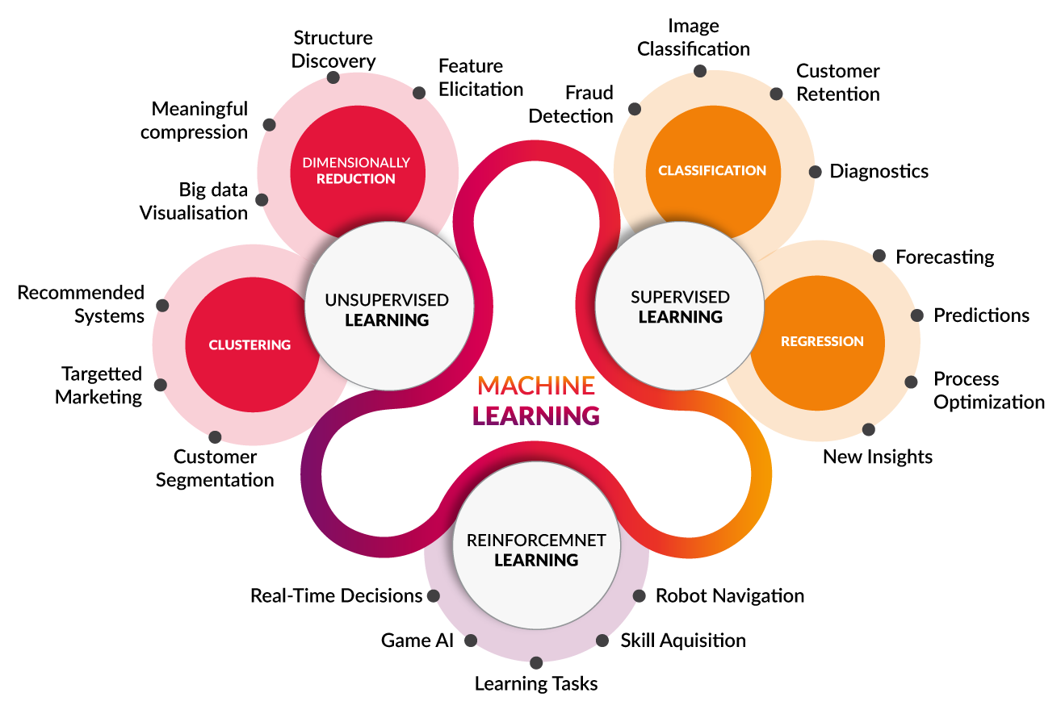
Types of machine learning Algorithms

Slide 7
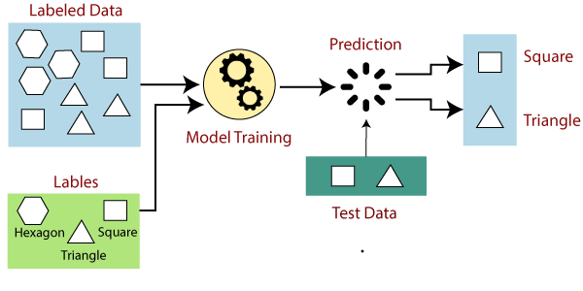
Supervised Learning
Supervised learning, also known as supervised machine learning, is a subcategory of machine learning and artificial intelligence. It is defined by its use of labeled datasets to train algorithms that to classify data or predict outcomes accurately. As input data is fed into the model, it adjusts its weights until the model has been fitted appropriately, which occurs as part of the cross validation process. Supervised learning helps organizations solve for a variety of real-world problems at scale, such as classifying spam in a separate folder from your inbox.
Supervised learning uses a training set to teach models to yield the desired output. This training dataset includes inputs and correct outputs, which allow the model to learn over time. The algorithm measures its accuracy through the loss function, adjusting until the error has been sufficiently minimized.

Slide 8
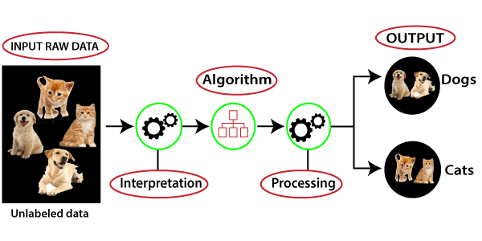
UNSUPERVISED LEARNING
Unsupervised learning, also known as unsupervised machine learning, uses machine learning algorithms to analyze and cluster unlabeled datasets. These algorithms discover hidden patterns or data groupings without the need for human intervention. Its ability to discover similarities and differences in information make it the ideal solution for exploratory data analysis, cross-selling strategies, customer segmentation, and image recognition. Unsupervised Learning draws inferences from datasets without labels. It is best used when we want to find patterns but don't know exactly what we are looking for. This makes it useful in cybersecurity where the attacker is always changing methods.
Unsupervised learning models are utilized for three main tasks—clustering, association, and dimensionality reduction.

Slide 9
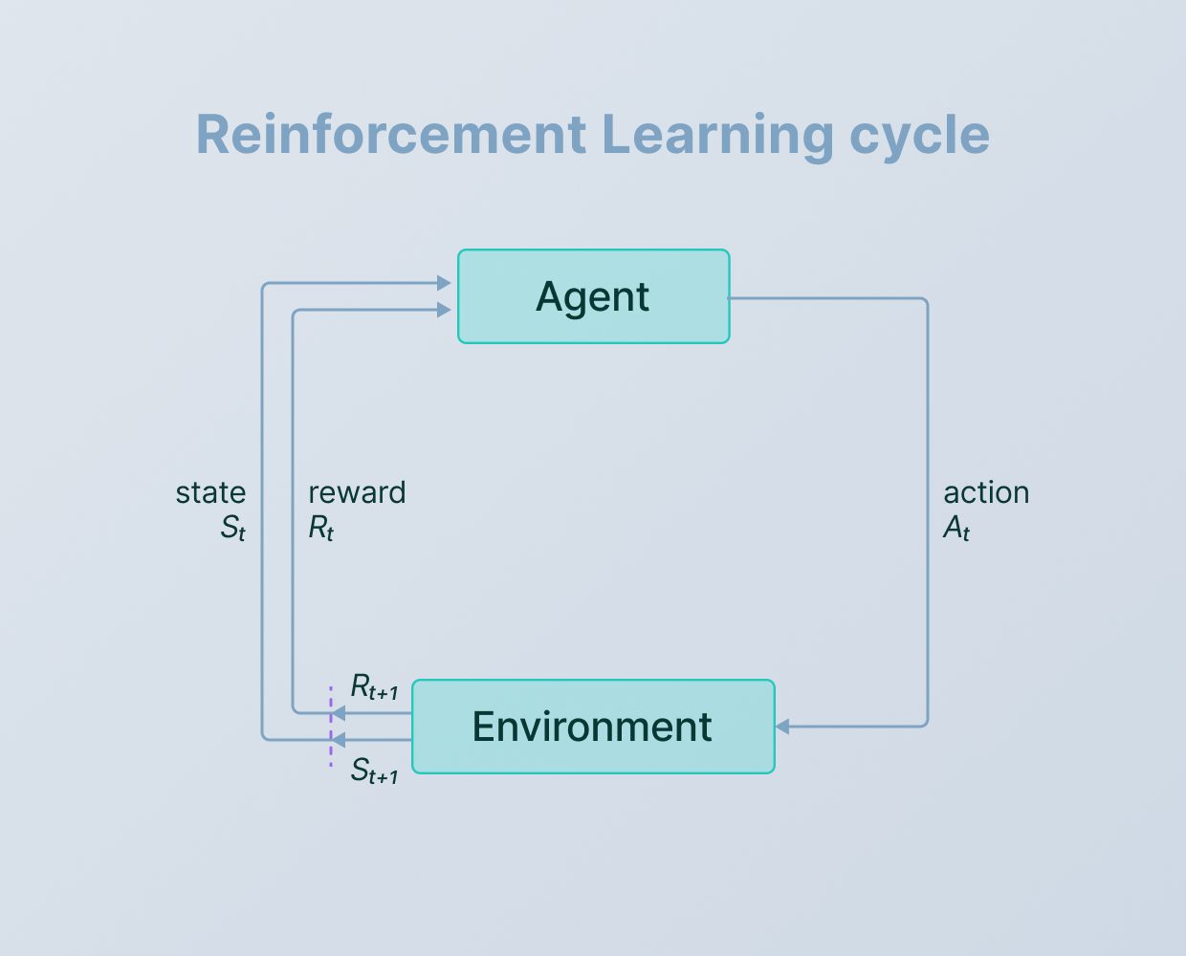
Reinforcement Learning
Reinforcement learning is a machine learning training method based on rewarding desired behaviors and/or punishing undesired ones. In general, a reinforcement learning agent . is able to perceive and interpret its environment, take actions and learn through trial and error.
In reinforcement learning, developers devise a method of rewarding desired behaviors and punishing negative behaviors. This method assigns positive values to the desired actions to encourage the agent and negative values to undesired behaviors. This programs the agent to seek long-term and maximum overall reward to achieve an optimal solution.
These long-term goals help prevent the agent from stalling on lesser goals. With time, the agent learns to avoid the negative and seek the positive. This learning method has been adopted in artificial intelligence (AI) as a way of directing unsupervised machine learning through rewards and penalties.

Slide 10
Algorithm Used
Logistic Regression
Logistic regression is one of the most popular Machine Learning algorithms, which comes under the Supervised Learning technique. It is used for predicting the categorical dependent variable using a given set of independent variables. Logistic regression predicts the output of a categorical dependent variable. Therefore the outcome must be a categorical or discrete value. It can be either Yes or No, 0 or 1, true or False, etc. but instead of giving the exact value as 0 and 1, it gives the probabilistic values which lie between 0 and 1. Logistic Regression is much similar to the Linear Regression except that how they are used. Linear Regression is used for solving Regression problems, whereas Logistic regression is used for solving the classification problems. In Logistic regression, instead of fitting a regression line, we fit an "S" shaped logistic function, which predicts two maximum values (0 or 1). The curve from the logistic function indicates the likelihood of something. Logistic Regression is a significant machine learning algorithm because it has the ability to provide probabilities and classify new data using continuous and discrete datasets. Logistic Regression can be used to classify the observations using different types of data and can easily determine the most effective variables used for the classification.

Slide 11
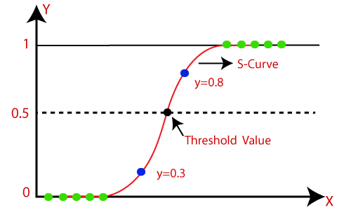
Logistic Function

Slide 12
Work Flow
1. Data Collection
The dataset used for the fraud detection system is derived from the Kaggle.
Kaggle is the world’s largest data science community with powerful tools and resources
It allows users to find datasets they want to use in building AI models, publish datasets, work with other data scientists and machine learning engineers, and enter competitions to solve data science challenges.

Slide 13
2. Data Preprocessing
Data preprocessing is a process of preparing the raw data and making it suitable for a machine learning model. It is the first and crucial step while creating a machine learning model.
The dataset that we use here is an imbalance dataset i.e., here we do not have equal number of fraud and legal transactions details. In the dataset, the number of legal transactions (284,807) is greater as compared to fraud (492). Hence to balance them is a challenge.
Imbalanced dataset cannot be fed into the model to predict the value.
Sampling Technique (Simple Random Sampling) is used to get the uniform dataset which can be fed into the model. It is a method that allows us to get information about the population based on the statistics from a subset of the population (sample), without having to investigate every individual. Simple random sampling is a type of probability sampling in which the researcher randomly selects a subset of participants from a population. Sampling is used because once it is applied to transform the training dataset, a suite of standard machine learning algorithms can then be used directly.

Slide 14
3. Data Analysis
Data analysis involves manipulating, transforming, and visualizing data in order to infer meaningful insights from the results.
The dataset contains transactions made by credit cards. This dataset presents transactions that occurred in two days, where we have 492 frauds out of 284,807 transactions. The dataset is highly unbalanced, the positive class (frauds) account for 0.172% of all transactions. Only 0.172% is fraud transactions.
It contains only numerical input variables which are the result of a PCA transformation. Features V1, V2, … V28 are the principal components obtained with PCA, the only features which have not been transformed with PCA are 'Time' and 'Amount'. Feature 'Time' contains the seconds elapsed between each transaction and the first transaction in the dataset. The feature 'Amount' is the transaction Amount, this feature can be used for example dependent cost-sensitive learning. Feature 'Class' is the response variable and it takes value 1 in case of fraud and 0 otherwise. The dataset does not contain any missing value for each column.

Slide 15
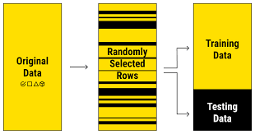
4. Train-Test Split
Splitting the dataset into training data and testing data. Training data is approximately 80% of the whole dataset and testing data is approximately 20%.
Finding the accuracy score of both training data and testing data is to be calculated.
Then checking that the model is not overfitted nor underfitted.

Slide 16
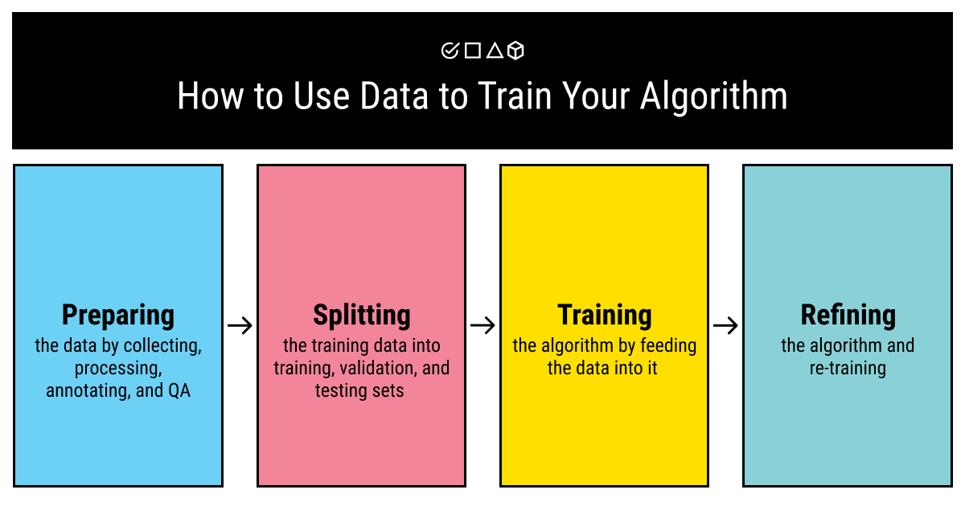
5. Model Training
The problem statement i.e. Fraud Detection System is a binary classification Problem. A Binary classification task refers to those classification tasks that have two class labels. Hence Logistic Regression model is used for model training.

Slide 17
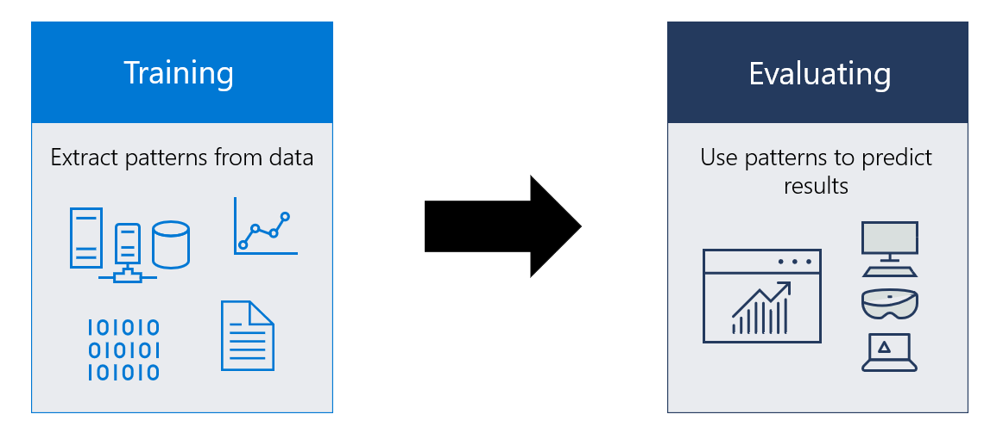
6. Evaluation
The model is evaluated by calculating the accuracy score of the training data as well as the test data. With the help of test data, predict the accuracy of the model. Accuracy score in machine learning is an evaluation metric that measures the number of correct predictions made by a model in relation to the total number of predictions made. We calculate it by dividing the number of correct predictions by the total number of predictions.
Accuracy score for the training dataset was approximately is 92.24%
Accuracy score for the testing dataset was approximately is 91.37%

Slide 18
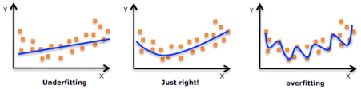
Checking the accuracy score for overfitting and underfitting
Overfitting : It is an undesirable machine learning behavior that occurs when the machine learning model gives accurate predictions for training data but not for new data. Overfitting occurs when train error is very small and test error is large. In the model there is vary less difference between the accuracy score of training data and testing data. Hence the model is not overfitted.
Underfitting : It is a scenario in data science where a data model is unable to capture the relationship between the input and output variables accurately, generating a high error rate on both the training set and unseen data. It means that your model makes accurate, but initially incorrect predictions. It suggests that the model is not able to generalize the correct relationship between the input and output variables. A significant relationship is present between the input variables and output classes ( fraud and legit classes). Hence fraud detection system is not underfitted.

Slide 19


System Requirements
Hardware requirements:
RAM: 4GB and above.
Processor: Intel i3 and above.
Hard Disk: minimum 500 GB.
Software Requirements:
OS: Windows or Linux.
Jupyter Notebook – Google Colab.
Setup tools and pip to be installed for 3.6 and above.
Language used: Python
Libraries/Modules: sklearn.model_selection , sklearn.metrics , sklearn.linear_model , sklearn.preprocessing

Slide 20

FUTURE Scope
Fraud detection have become essential for banks and financial institution, to minimize their losses. Fraud detection systems will continue to leverage machine learning algorithms and AI techniques to improve their accuracy and efficiency. These systems will become more adept at identifying new and emerging fraud patterns by analyzing vast amounts of data and detecting anomalies, Although there is unavailability of credit card transaction dataset for researchers. With the increasing volume and velocity of transactions, fraud detection systems will need to operate in real-time to swiftly identify and respond to fraudulent activities. By continuously monitoring transactions, systems can flag suspicious behavior and take immediate action to mitigate risks.

Slide 21


